Slide 1

Proyecto Minut-IA
PRESENTACIÓN CAPSTONE

Slide 2
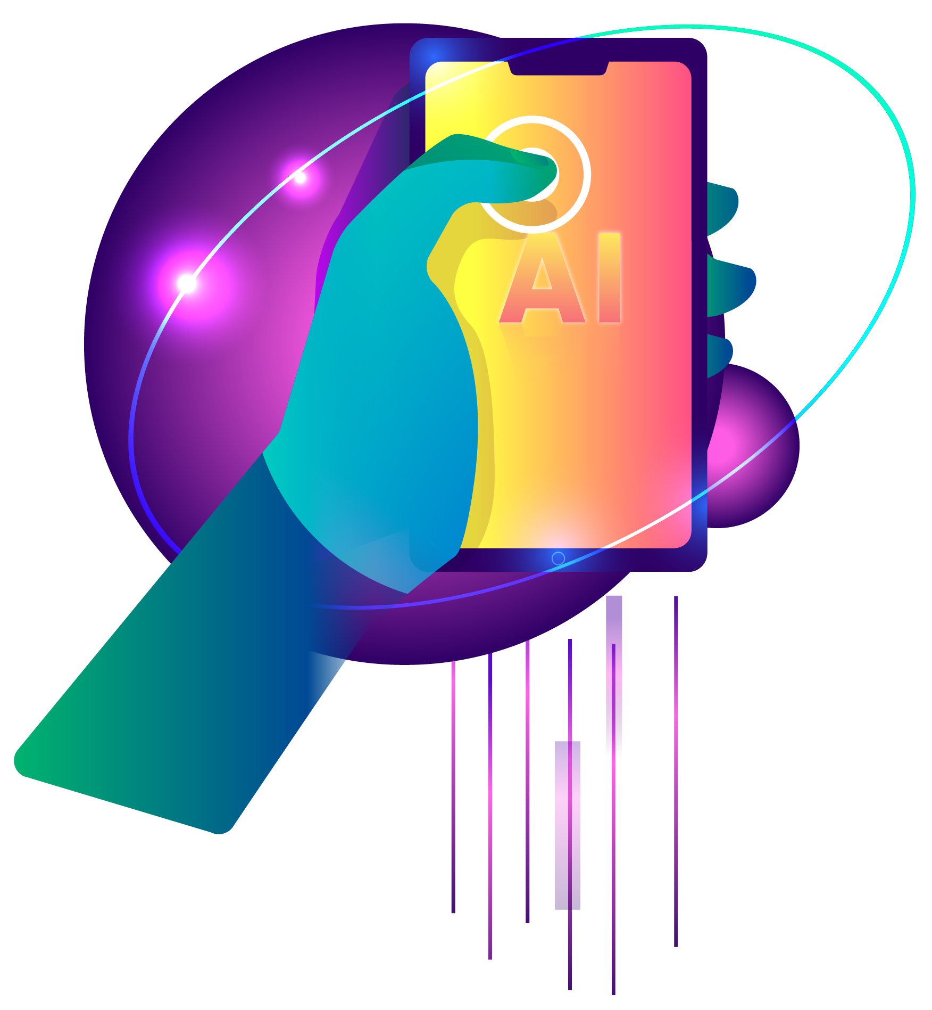
Team Members and Roles:
Gerson Figelist
Scrum Master
Dev FrontEnd
UI Designer
Alejandro Valenzuela
Product Owner
Dev BackEnd
Architect Software
Diego Meynard
Scrum Team
Dev FrontEnd
QA Analyst

Slide 3
Problem Description
Problem
Solution Proposal
The lack of time and planning in modern life leads to eating-related issues affecting people across different socioeconomic levels, causing:
Food Waste.
Unnecessary Expenses
Poor Nutrition.
A mobile app with AI that optimizes meal planning based on available food and user preferences.
It allows you to scan receipts to register products and generate personalized menus, offering:
Purchase recommendations to avoid excesses.
Savings and waste reduction reports.
Expiration reminders to take advantage of products.
This app improves nutrition, reduces waste and optimizes the budget.

Slide 4
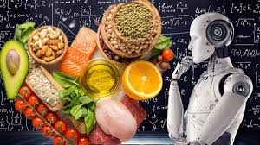


General Objective
Revolutionize the way people manage their food by transforming their regular food purchases into optimized meal plans, reducing food waste, time and making meal planning easier through personalized and accessible artificial intelligence.

Slide 5


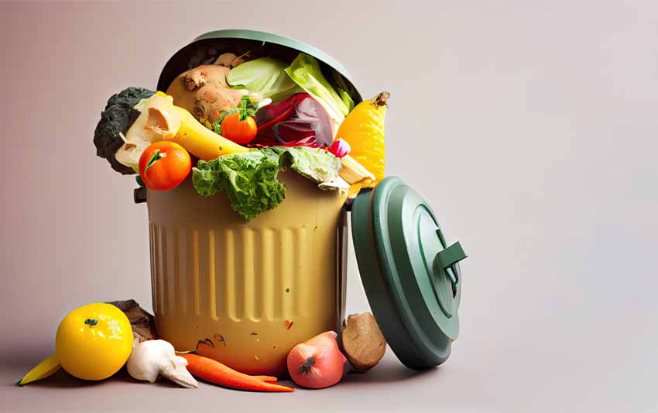



Specific Objectives
Reduce unnecessary expenses
Reduce food waste
Time saving

Slide 6
Scope and Limitations
Scope
Limitations
1 -
Automated food registration.
Compatibility only on Android
Geographic scope limited to Chile.
Errors or problems related to external services.
2 -
Food inventory.
3 -
Meal plan creation.
4 -
Meal plan recipes.
5 -
Usage notifications .
6 -
Meal plan compliance objectives
7 -
Purchase and food usage recommendations.
8 -
Personalized dietary adjustments for each type of user.

Slide 7
Career Competencies
Perform certification testing of both products and processes using good practices defined by the industry..
Manage IT projects, offering alternatives for decision-making in accordance with the organization's requirements.
Build data models to support the organization's requirements according to a defined and scalable design over time.
Develop a software solution using techniques that allow the development and maintenance process to be systematized, ensuring the achievement of objectives.

Slide 8
Project Methodology

Slide 9


SCRUM
General information
Working method | Software used | Number of Stories
Sprint Quantity | Average Story Points | Number of tasks
12
Scrum
JIRA
5
44
53

Slide 10
User stories
Sprint number | History | Status
1 | I want to register in the app | Completed
1 | Scan purchase receipt | Completed
1 | Manage my dispensation | Completed
2 | I want to create a minute plan | Completed
2 | Quiero personalizar el plan de minuta | Completed
2 | I want to customize the minute plan | Completed
3 | Food recommendations. | Completed
3 | App and Minute Reminders. | Completed
4 | Notify when there is leftover food. | Completed
4 | Discount used food from the pantry. | Completed
5 | Recommendations to optimize purchases. | Completed
5 | Visualization of achieved objectives. | Completed

Slide 11
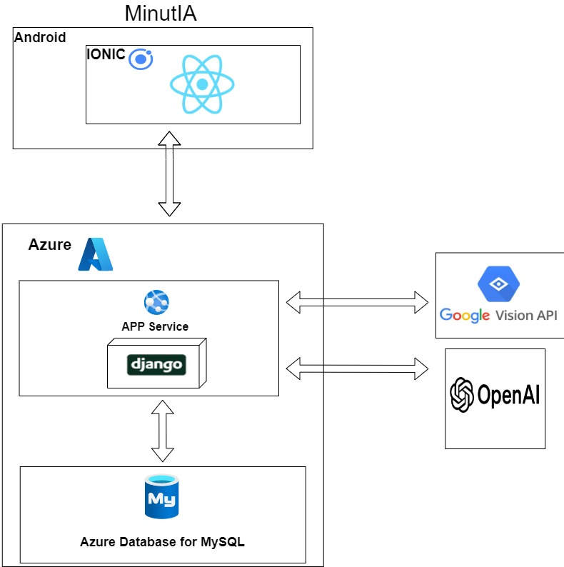

Project Architecture

Slide 12
Technologies Used
Ionic + React
Django
MySQL
Interface
APIRest
Database
API OpenAI - API Google Vision
Azure
Cloud Platform
External microservices

Slide 13
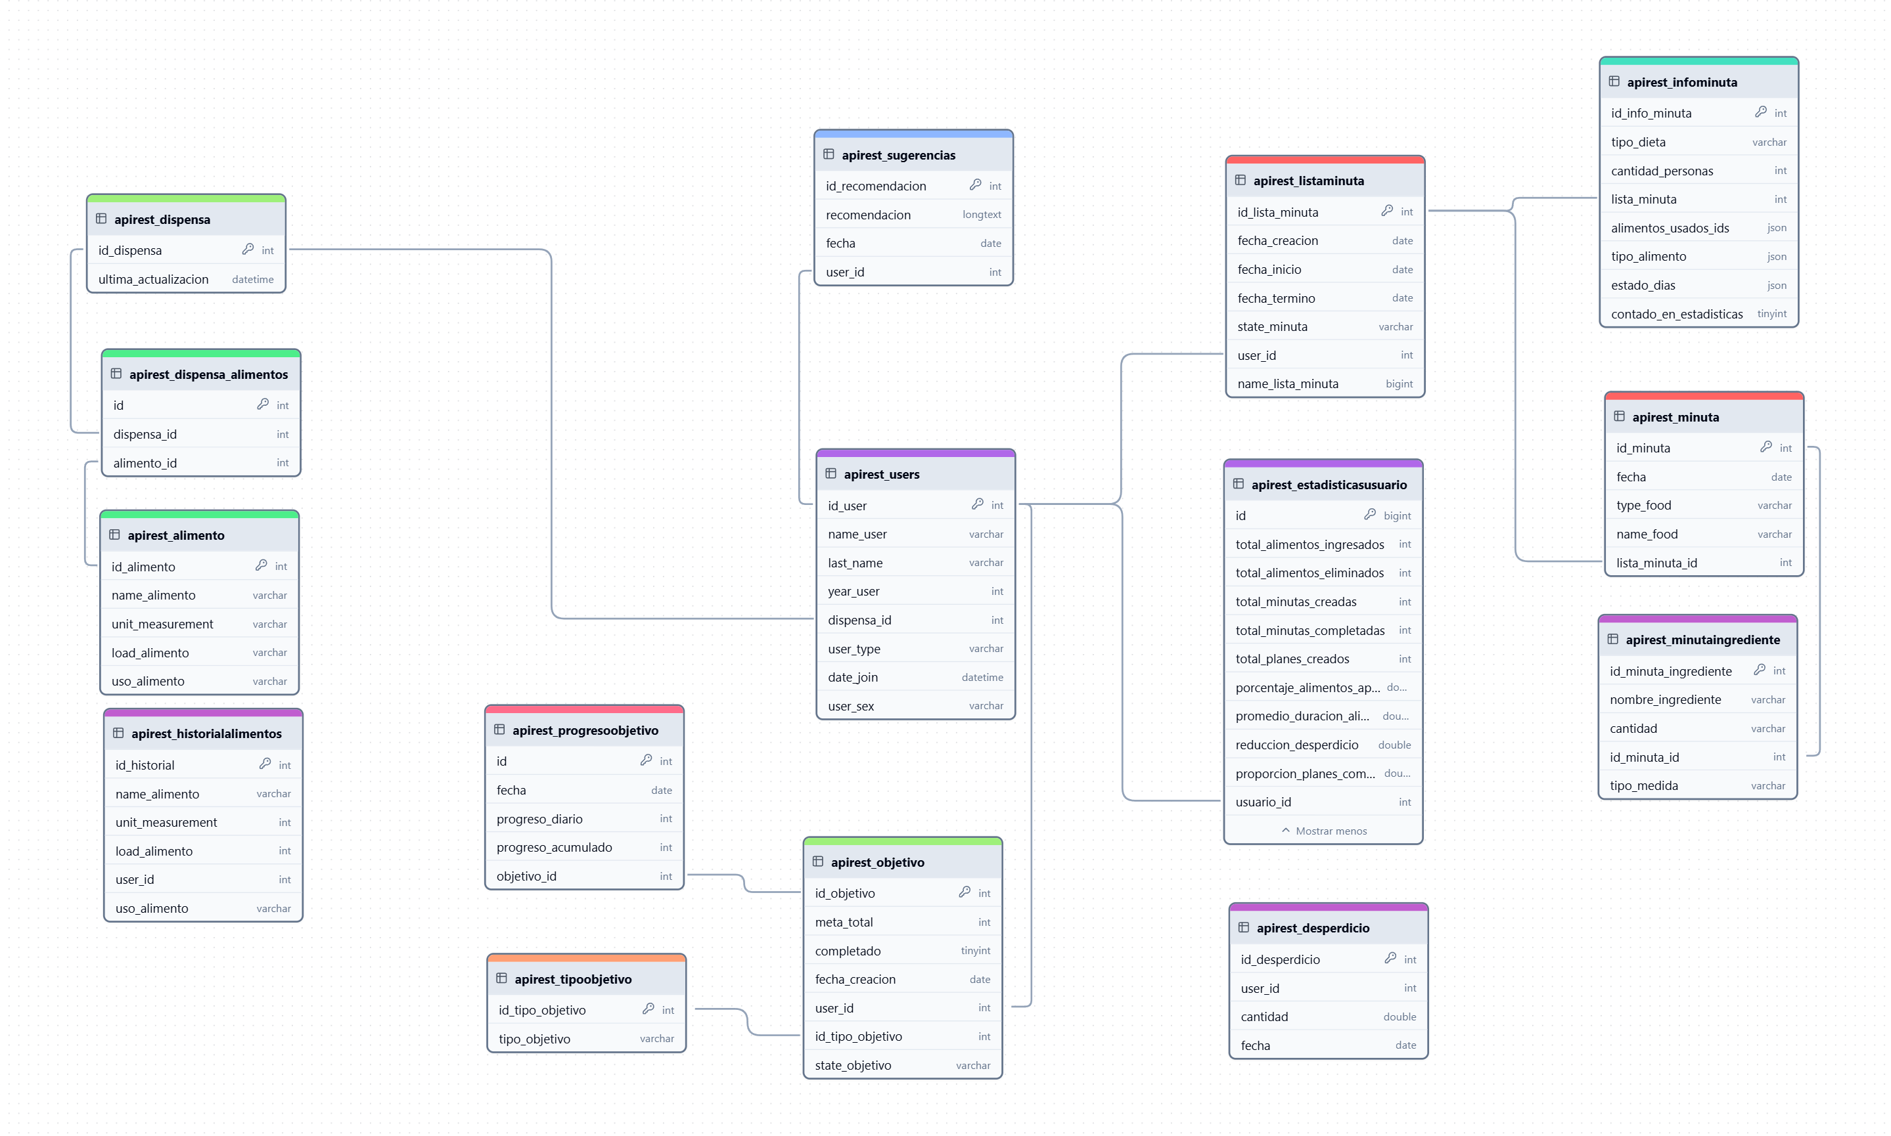
Data Model

Slide 14
Using Prompts

Slide 15
Prompt Structure
In the development of our application, the functionalities driven by AI prompts have seen notable progress thanks to a structured approach. After testing and analyzing various formats, we have defined an optimized base structure that seeks to maximize the clarity, coherence and effectiveness of interactions. This setup was built following the following key parameters:
Context: It provides the general framework of the request, helping the model understand the purpose or situation.
Output format: Defines how the response should be presented, guaranteeing consistency and adaptation to the requirements.
Additional information: Specific details relevant to the request that enrich the context and improve the accuracy of the response.
Instructions: Clear and specific instructions that guide the execution of the requested task.

Slide 16
Examples of Implemented Promts

Slide 17
Food income
Tengo la siguiente boleta de supermercado: '{extracted_text}'.
El formato del detalle de productos en la boleta es el siguiente:
Cada línea incluye:
-Código de producto (numérico).
-Nombre del producto.
-algunos pueden tener la cantidad del contenido (por ejemplo, '1 kg').
-Cantidad del producto (por ejemplo, '8 x' para 8 unidades).
-Precio unitario del producto en una columna alineada a la derecha.
-Algunos productos pueden tener líneas adicionales que indican descuentos aplicados."
Y la tarea que necesito es Extraer los alimentos, la unidad de medida (kg, gr, lt, ml) y la cantidad en formato JSON de la siguiente manera:
formato de salida:
[
{{ "producto": "nombre del producto", "unidad": "kg o gr o lt o ml", "cantidad": "cantidad" }}
]
Instrucciones:
-Envía solo el JSON con los alimentos sin texto adicional.
-En caso de que no puedas determinar la unidad de medida, y el producto es sólido, asigna "unidad": "kg"; -si es líquido, asigna "unidad": "lt". Evita usar "unidad" como valor de unidad.
The variable "extracted_text" is provided, which contains the text extracted from the ballot, already with acronym checking processed to ensure consistency.
In addition, a defined output format is established and a clear set of rules is provided that the AI ​​must follow to insert the products appropriately.

Slide 18
food categorization
Tengo la siguiente lista de alimentos en formato JSON: {alimentos_list}.
Para cada producto en esta lista, añade únicamente la clave "uso_alimento", indicando en qué comidas se puede usar el alimento (por ejemplo, "desayuno", "almuerzo", y/o "cena").
Aquí tienes algunas reglas para la clasificación:
- Productos como cereales, lácteos, frutas y pan suelen usarse en "desayuno".
- Carnes, pescados, arroces, pastas y vegetales suelen usarse en "almuerzo" y "cena".
- Dulces o galletas suelen usarse en "desayuno" o "merienda", pero no en comidas principales como almuerzo o cena.
- Si tienes dudas sobre un alimento específico, inclúyelo en todas las comidas.
Formato de salida:
[
{{ "producto": "nombre del producto", "unidad": "kg o gr o lt o ml", "cantidad": "cantidad", "uso_alimento": "desayuno, almuerzo, cena" }}
]
Instrucciones
-No modifiques el nombre del producto, la unidad ni la cantidad.
-Devuelve solo el JSON actualizado con la clave "uso_alimento" correctamente asignada.
Classifies foods in JSON by assigning them the key "food_use" according to predefined rules based on their typical use in meals (breakfast, lunch, dinner, etc.). Maintains the original data and generates consistent structured output.

Slide 19
Food income
Tengo la siguiente despensa: {alimentos_list} y necesito crear una minuta Solo puedes utilizar estos ingredientes.
**Objetivos principales:**
1.Necesito una minuta exclusivamente para {type_food} para {people_number} personas, con preferencia {dietary_preference}, comenzando desde {starting_date}.
2.Las fechas deben ser consecutivas y no deben faltar días. Calcula cuántos días puede durar la minuta en función de la cantidad de alimentos disponible, cantidad de personas y preferencia. Utiliza la cantidad adecuada de ingredientes por día.
3.Aprovecha al máximo todos los ingredientes disponibles en la despensa para crear platos variados y balanceados.
4.Responde únicamente en formato JSON. Proporciona la respuesta en el siguiente formato JSON:
Formato de salida:
{{ "name_food": "nombre del plato",
"type_food": "type_food",
"fecha": "YYYY-MM-DD",
"ingredientes": [
{{ "nombre": "ingrediente1", "tipo_medida": "medida1" ,"cantidad": "cantidad1" }},
{{ "nombre": "ingrediente2", "tipo_medida": "medida2" ,"cantidad": "cantidad2" }},
... ] }}
This is a fragment of the promt that requests the generation of the minutes, in this part the variables of:
Food_list: contains the pantry products
Type_food: the types of food such as breakfast, lunch or dinner
People_number: the number of people
Dietary_preference: the type of diet
Starting_date: when this minute will start

Slide 20
Demo Minut-IA

Slide 21
!Thank you for your time!

